Slide 1
ZOMATO RESTAURANT ANALYISIS
B N PRITHVIRAJ
DS JULY 2024 BATCH

Slide 2
PROBLEM STATEMENT
You are hired as a consultant data analyst by Zomato where the team is looking for expansion and opening more restaurants. Your task is to develop strategies/suggestions for opening newer restaurants.

Slide 3
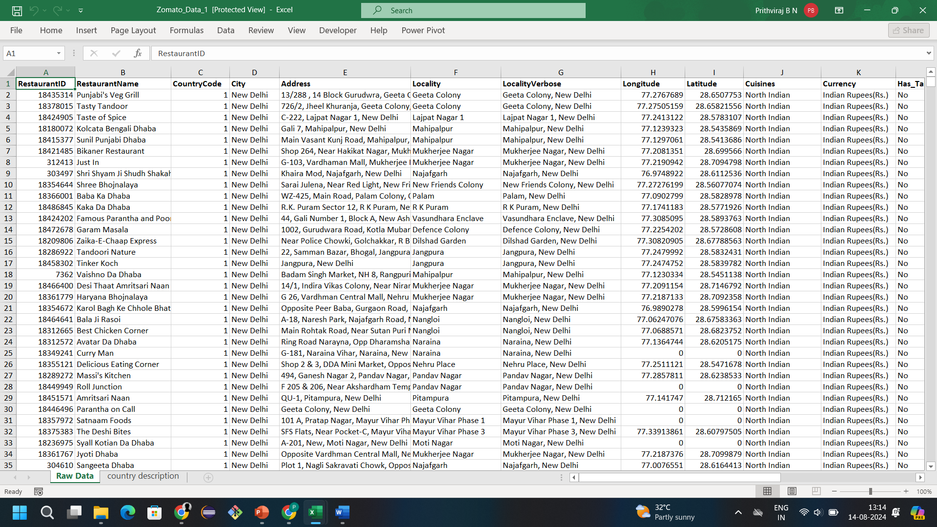
RAW DATA

Slide 4
DATA COLUMN OVERVIEW

Slide 5
NUMBER OF RESTAURANTS IN EACH COUNTRY
India leads the market with 8,652 restaurants, accounting for ~90.6% of the total.
Mature markets like the U.S. (434) and U.K. (80) show established competition.
Emerging markets such as Brazil, South Africa, and UAE (60 each) offer growth potential.
Smaller markets like New Zealand, Turkey, and Australia present limited but valuable expansion opportunities.
Underdeveloped markets like the Philippines, Indonesia, and Sri Lanka have low competition, making them attractive for new ventures.
Untapped markets like Canada (4) offer high potential but come with greater risks.

Slide 6
NUMBER OF RESTAURANTS IN EACH YEAR
The number of restaurants from 2010 to 2018 shows a generally positive trend with some fluctuations.
In 2010, there were 1,080 restaurants.
The number peaked at 1,102 restaurants in 2018, indicating growth in the sector.
Notable declines occurred in 2012, when the count dropped to 1,022, and again in 2015 to 1,024.Despite these dips, the overall trend remains upward.
The total number of restaurants over the period amounts to 9,551.The highest count of restaurants was recorded in 2018, the final year of the observed period.

Slide 7
SERVICES AVAILABLE
74% of restaurants do not offer online delivery, indicating a significant market gap.
Only 26% provide online delivery, presenting an opportunity for growth and customer reach.
Offering online delivery can be a key differentiator for new or existing businesses.
88% of restaurants do not offer table booking services, highlighting a significant opportunity to enhance customer experience.
Incorporating table booking options could attract more diners and boost customer satisfaction.

Slide 8
AVERAGE RATING ACROSS DIFFERENT COUNTRIES
India has the lowest average rating (2.77), indicating potential service quality issues.
Philippines (4.47), Turkey (4.30), and Indonesia (4.30) lead in customer satisfaction with the highest ratings.
UAE (4.23), New Zealand (4.26), and South Africa (4.21) also show high customer satisfaction.
Moderate ratings in Canada, Singapore, and Australia (around 3.6) suggest room for improvement.
High-rated markets present opportunities for expansion, leveraging strong customer perceptions.

Slide 9
PRICE RANGE VS NUMBER OF RESTAURANTS
Price range 1 has the largest share with 4,444 restaurants, making it the most common price point.
Price range 2 has a significant presence with 3,113 restaurants, indicating a notable portion of the market.
Price range 3 includes 1,408 restaurants, showing a moderate representation.
Price range 4, the least frequent, has 586 restaurants, reflecting a smaller, premium segment.
Overall, there is a strong concentration in lower price ranges, highlighting affordability as a key market factor.

Slide 10
AVERAGE PRICE RANGE ACROSS DIFFERENT COUNTRIES
India has the lowest average price range at 1.72, indicating generally lower dining costs.
Qatar, Singapore, and South Africa have the highest price ranges, reflecting more expensive dining experiences.
Brazil, Philippines, and New Zealand also show higher-than-average dining costs.
United States, Australia, and Canada offer more affordable dining options with moderate price ranges.
Turkey, Indonesia, and UAE fall in the middle range, presenting balanced dining costs across these markets.

Slide 11
TOTAL NUMBER OF VOTERS IN EACH COUNTRY
India dominates with 1.18 million voters, showing the highest customer engagement.
United States and UAE follow with 185,848 and 29,611 voters, reflecting strong participation.
South Africa, UK, and Indonesia show moderate engagement with 16,000–19,000 voters.
Smaller markets like Sri Lanka, Australia, Brazil, Singapore, and Canada have limited engagement, with fewer than 3,000 voters each.
Smaller markets may offer niche opportunities for growth, while India remains the most dominant.

Slide 12
AVERAGE NUMBER OF VOTERS IN EACH COUNTRY
Indonesia has the highest average voter count at 772.10, indicating a robust voter base.
Countries like United Arab Emirates, Turkey, and the United States fall in the middle range with average voter counts between 400-500, showing significant voter engagement.
Philippines and South Africa also exhibit considerable voter activity.
Voter counts drop in New Zealand, United Kingdom, and Qatar, with averages between 163-243.Sri Lanka and India show even lower average voter counts.
Australia and Canada have relatively modest voter engagement.
Singapore and Brazil have the lowest averages, with Brazil's average particularly low at 19.62.
The grand total average across all countries is 156.91, reflecting a wide range of voter engagement worldwide.

Slide 13
SUGGESTED COUNTRIES
The four countries identified - Indonesia, United Arab Emirates (UAE), Turkey, and the Philippines- meet these criteria based on a combination of factors including voter engagement, the absence of online delivery options, and favourable pricing dynamics.
Key Criteria for Selection:
High Average Number of Voters: A higher number of voters in the sector suggests strong consumer engagement and interest in dining experiences. It indicates a robust food culture where people actively participate in rating and reviewing restaurants, which is a proxy for market demand.
Absence of Online Delivery Options: The lack of online delivery infrastructure can be seen as an opportunity to fill a gap in the market. While this might indicate lower technological adoption, it also presents a chance to introduce innovative delivery solutions, which could give the new restaurant a competitive edge.
Favourable Price Range: A good price range that aligns with local spending habits is crucial for success. If consumers are willing to spend a significant amount on dining out, there’s potential for profitability even with moderate competition.
Suggested countries are Indonesia, United Arab Emirates, Turkey, Philippines

Slide 14
COUNTRY VS NO. OF RESTAURANT AND AVG. OF VOTERS
Indonesia has 21 restaurants and the highest average voter count at 772.10, indicating a large and engaged voter base.
United Arab Emirates has 32 restaurants and an average voter count of 572.22, reflecting a moderately high voter base.
Turkey, with 34 restaurants, has an average voter count of 431.47, suggesting significant voter participation.
Philippines, with 22 restaurants, has the lowest average voter count among the four countries at 407.41, but still shows notable voter engagement.

Slide 15
SELECTED COUNTRIES VS AVERAGE RATING
High Customer Satisfaction: Current ratings indicate strong customer satisfaction across Indonesia, Philippines, Turkey, and UAE.
Opportunity for Innovation: Despite high ratings, there is potential for innovation to further enhance customer experiences.
Unique Dining Experiences: New restaurants can elevate satisfaction by offering unique and innovative dining options.
High Standards Required: New entrants must match or exceed existing quality ratings to succeed in these competitive markets.
Leverage Successful Strategies: Focusing on exceptional quality and adopting successful strategies from the Philippines can help new restaurants thrive.

Slide 16
SELECTED COUNTRIES VS AVERAGE PRICE RANGE
The price ranges reflect general expenditure levels on food in each country, indicating how much consumers are willing to spend on dining experiences.
Philippines and UAE have the highest average price ranges at 3.36 and 3.25, respectively, suggesting that consumers are willing to spend more on dining out. This indicates a higher potential revenue for restaurants in these markets.
Indonesia (2.95) and Turkey (2.82) have slightly lower average price ranges, indicating that while consumers are still willing to spend, they may be more price-sensitive compared to those in the Philippines and the UAE.
The average price ranges in Indonesia, Philippines, Turkey, and UAE provide valuable insights into consumer spending behavior, which can help guide the financial strategy for new restaurant openings.

Slide 17
CITY SELECTION
Tangerang City, Indonesia: Low competition with only 2 restaurants and high voter engagement presents a prime opportunity for a new restaurant, especially with online delivery options.
Pasig City, Philippines: Similar to Tangerang, with 3 restaurants and strong voter interest, there’s significant potential for a new restaurant to capture market share, particularly through online delivery.
Istanbul, Turkey: With 14 restaurants and high average votes, the strong consumer demand indicates that a new restaurant could succeed by offering a unique concept or superior quality.
Dubai, UAE: Also having 14 restaurants, Dubai’s high voter engagement and affluent market support the introduction of new dining options, especially if targeting a specific niche.
Overall Opportunity: High voter engagement across these cities underscores the potential for new restaurants to thrive, particularly when leveraging online delivery and unique dining experiences.

Slide 18
CUISINE SELECTION
Indonesia: Prioritize Sunda and regional cuisines to achieve high customer ratings.
Philippines: Emphasize Filipino dishes and Filipino-Mexican fusion for better feedback.
Turkey: Focus on local favorites like Bar Food and Desserts, avoiding less popular international options like Italian.
UAE: Center the menu around highly rated Indian and Continental dishes, steering clear of low-rated combinations like Seafood-American.
Tailored Offerings: Align cuisine offerings with local preferences and avoid unpopular choices to enhance customer satisfaction and boost restaurant success.

Slide 19
RECOMMENDED CUISINES
Indonesia:
Focus on Sunda & regional cuisine for high ratings.
Philippines:
Emphasize Filipino and Filipino-Mexican fusion dishes.
Turkey:
Prioritize local favourites like Bar Food and Desserts; avoid less popular international options like Italian cuisine.
UAE:
Centre the menu around highly rated Indian and Continental dishes, while steering clear of low-rated combinations like Seafood-American.

Slide 20
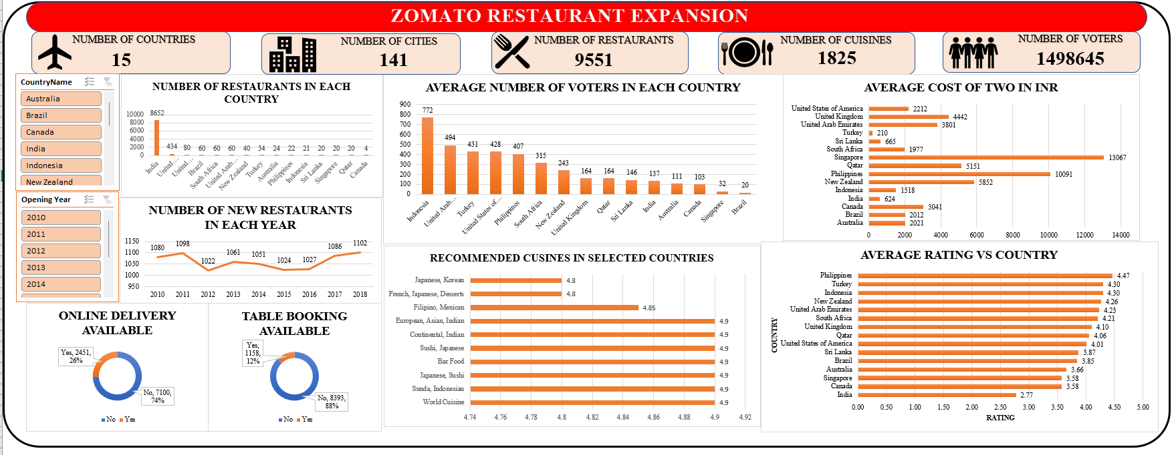
DASHBOARD

Slide 21
THANK YOU

